Slide 1
Introductory Concepts in Nutrition
Topic 6
Nutritional assessment: Direct and indirect methods
Susmita Ghosh, MS
Dr. Ratthiphone Oula, MD, MCN
Dr. Nilupa S. Gunaratna, MS, PhD
Training by Applied Nutrition Research Capacity Building (ANRCB), a project of the Lao American Nutrition Initiative (LANI)
This work is made possible through support from USAID/Laos as a supplement to a USAID Cooperative Agreement #7200AA18CA00009
(LASER-PULSE) to Purdue University. Contents reflect the views of the author(s) and do not necessarily reflect those of USAID.
For more information, please contact Catholic Relief Services Laos.
Notes:
Goal: 60 minutes
Welcome to the ANRCB Project’s Module on Introductory Concepts in Nutrition. In this video, we will discuss …

Slide 2
Learning objectives
By the end of topic 6, participants will be able:
To explain the importance of nutritional assessment for indicating nutritional well-being.
To recognize different nutritional assessment methods and their purposes and applications.
To explain how nutritional assessment helps to indicate the nutritional status of an individual, community, or population group, track healthy growth of children, and identify risk of non-communicable diseases.

Slide 3
Nutritional status
Nutritional status is the current body status of a person or a population group, related to their state of nourishment (the consumption and utilization of nutrients)
Nutritional status is determined by a complex interaction between internal (constitutional) factors and external (environmental) factors:
  Internal factors include age, sex, eating behavior, physical activity, and diseases
  External factors include food safety, culture, and social and economic circumstances
Source: Gibson, 2005

Slide 4
Nutritional assessment
Nutritional assessment is the interpretation of anthropometric, biochemical (laboratory), clinical, and dietary data to determine whether a person or group of people are well-nourished or malnourished
Nutritional status is assessed by direct and indirect methods
  Direct methods deal with individuals, while indirect methods use community indices that reflect the community’s nutritional status
Nutritional assessment and analysis
ASSESSMENT
of the nutritional situation in target population
ACTION
based on the analysis and available resources
ANALYSIS
of the causes of the problem
Source: Gibson, 2005
Source: UNICEF, Triple A cycle
Notes:
It includes taking anthropometric measurements and collecting information about a client’s medical history, clinical and biochemical characteristics, dietary practices, current treatment, and food security situation.
Gibson, 2005

Slide 5

Nutritional assessment at different levels
Data can be available at multiple levels: countries, communities, households, and individuals. Some examples:
Countries: Food balance sheets are constructed using country-level data for individual food commodities
Communities: Food prices are observed at markets where products are bought and sold
Households: Household food consumption
Individuals: Anthropometric (body) measurements or biochemical measurements (biomarkers)
Individuals
Modified from: Lele, U., Masters, W. A., Kinabo, J., Meenakshi, J. V., Ramaswami, B., Tagwireyi, J., & Goswami, S. (2016). Measuring food and nutrition security: An independent technical assessment and user’s guide for existing indicators. Rome: Food Security Information Network, Measuring Food and Nutrition Security Technical Working Group, 177.
Notes:
https://openknowledge.worldbank.org/handle/10986/24953
This socio ecological approach to categorize the underlying data helpful when indicators combine measures from different scales, as in the Prevalence of Undernourishment 9PoU) which includes the data observed at national, household and individual scales
Sometimes socio ecological approach use the pairs of people such as the mother child dyad measured in breastfeeding indicators/ the community level measures in WASH indicators
Different scales indicators can be combined to get the multidimensional measures such as global hunger index (GHI) for year to year comparison

Slide 6
Purpose and application of nutritional assessment
Different types of direct nutritional assessment
Nutritional assessment is used:
To identify individuals or population groups at risk of becoming malnourished
To develop health care programs that address community needs as identified by the evaluation
To assess the efficacy of the nutritional interventions and programs
Nutritional assessment | Example of nutritional indicator | Application
Anthropometry | Height/length for age, weight for height, weight for age, stunting, wasting, & underweight | Assess child growth and development
Biochemical/ laboratory | Prevalence of serum/plasma retinol <0.70 micromol/L in pre-school age children <2% 2-9% 10-19% >=20% | Determine level of public health problem: None Mild Moderate Severe
Clinical | Proportion of pregnant women with nightblindness ≥ 5% | Identify moderate public health problem
Dietary | Proportion of children consuming an adequate amount of vitamin A | Quantify dietary quality and nutrient adequacy
Source: https://www.who.int/data/nutrition/nlis/info/vitamin-a-deficiency

Slide 7
Anthropometric assessment
Provides a valuable assessment of nutritional status in a population (children or adults).
Rationale for children: All of the world’s children grow similarly, if they are fed well, receive good care, and remain free of infectious diseases and deprivations
Anthropometric measurements are quantitative, noninvasive, less expensive, and require less training, equipment, and supplies
The core elements of anthropometry are height (or recumbent length for very young children),weight, and body proportions.
Different anthropometric measures such as waist circumference (WC), hip circumference (HC), body mass index (BMI), waist-to-hip ratio, and waist-to-height ratio are commonly used to predict risk of non-communicable disease such as diabetes and hypertension.
Source: World Health Organization. (2006). WHO child growth standards: length/height-for-age, weight-for-age, weight-for-length, weight-for-height and body mass index-for-age: methods and development. World Health Organization.

Slide 8
Anthropometric measurement
Weight: Weight is measured for children and as well as for adults to identify the normal growth for children and find out the risk of non-communicable disease for adults.
  Calibrated beam or a digital infant scale is used to measure weight for children
  A balanced floor scale or electronic floor scale is used to measure weight for adults
Recumbent length: Recumbent length is measured for children under 2 years of age.
Height: Height is measured for children 2 years and older who are more than 87 cm tall and for adults.
  Measuring height requires a standard measuring board with a moveable headboard (stadiometer) attached to a flat wall. Length is measured on a flat surface with a movable footboard.
Source: ANTHROPOMETRIC MEASUREMENTS (ca.gov)

Slide 9
Anthropometric measurement
Head circumference: Head circumference is a measurement of a child's head around its largest area
  The head circumference of infants increases rapidly in the first 2 years of life
  Increase in head circumference in the first 2 years of life is affected by nutritional status and non-nutritional factors
Mid upper arm circumference: MUAC is a measure of the sum of the muscle and subcutaneous fat in the upper arm.
  With acute malnutrition, both fat and muscle are reduced in the upper arm
  It can be used as an indicator for body composition in adults and children
Source: ANTHROPOMETRIC MEASUREMENTS (ca.gov)
Notes:
MUAC is commonly used in the community to identify and refer children 6−59 months of age with acute malnutrition, and either MUAC or WHZ is used in health facilities to diagnose children with acute malnutrition and enroll them in treatment

Slide 10
Anthropometric measurement
Hip and waist measurement: Waist circumference is measured halfway between the lower ribs and the iliac crest, while hip circumference is measured at the largest circumference around the buttocks.
  Waist circumference is related to insulin resistance
  A waist circumference greater than 94 cm in men and 80 cm in women has been associated with increased risk for cardiovascular disease
Source: ANTHROPOMETRIC MEASUREMENTS (ca.gov)
Notes:
Iliac crest – curved area at top of ilium (big bones of the pelvis)

Slide 11
Nutritional indices
Most single anthropometric measurements do not specifically assess nutritional status
Nutritional indices are derived by combining two or more anthropometric measurements
Different types of nutritional indices are:
  Body mass index (BMI)
  Waist-to-hip ratio (WHR)
  Weight-for-height z-score
Source: DAPA Measurement Toolkit (mrc.ac.uk)

Slide 12
Nutritional indices
Body mass index (BMI): an anthropometric indicator based on weight-to-height ratio. It is estimated by dividing weight (kg) by height squared (m²).
  Adults are considered malnourished if their BMI is less than 18.5, normal from 18.5 to 24.9, and overweight if ≥ 25
Weight-for-height: an indicator of body composition.
  Depends on sex and age
Waist-to-hip ratio (WHR): Waist circumference divided by hip circumference.
  Cutoffs for WHR are ≥ 0.85 for women and ≥ 1.00 for men
Source: DAPA Measurement Toolkit (mrc.ac.uk)
Notes:
For later – weight for height in adults
Reference values by age, sex, and frame size can be used to estimate desirable body weights (% desirable body weight = (actual weight / ideal body weight) x 100), which are categorized by cutoff points.
Review cutoffs for WHR

Slide 13
Biochemical methods
Biochemical data can identify or diagnose a nutritional problem, including nutrient deficiencies and/or toxicities, in an individual.
It can also be used to assess the nutritional status of a population.
Biochemical measurements can reflect the immediate past intake of nutrients, or the changes produced by a long-standing deficient intake.
Biochemical parameters can be used for acute or subclinical conditions when other methods of nutritional assessment fail to identify a condition.
Some biochemical measurements are affected by other factors (for example, inflammation)
Source: Biochemical methods in nutritional assessment (cambridge.org)

Slide 14
Biochemical methods
Biochemical assessment includes two types of test: static and functional.
Static tests include:
  Measurement of nutrient concentration in blood, urinary excretion and urinary metabolites of a nutrient, abnormal metabolites in urine/blood due to nutrient deficiency
  Measurement of changes in blood constituents or enzyme activities
  Measurement of ‘tissue specific’ chemical markers
  Saturation, loading, and isotope tests
Functional tests reflect the failure of function or physiologic process as a result of nutritional deficiency.
  For example: visual adaption to darkness will be compromised by vitamin A deficiency
Source: Biochemical methods in nutritional assessment (cambridge.org) & Biochemical Assessment PowerPoint (slideshare.net)

Slide 15
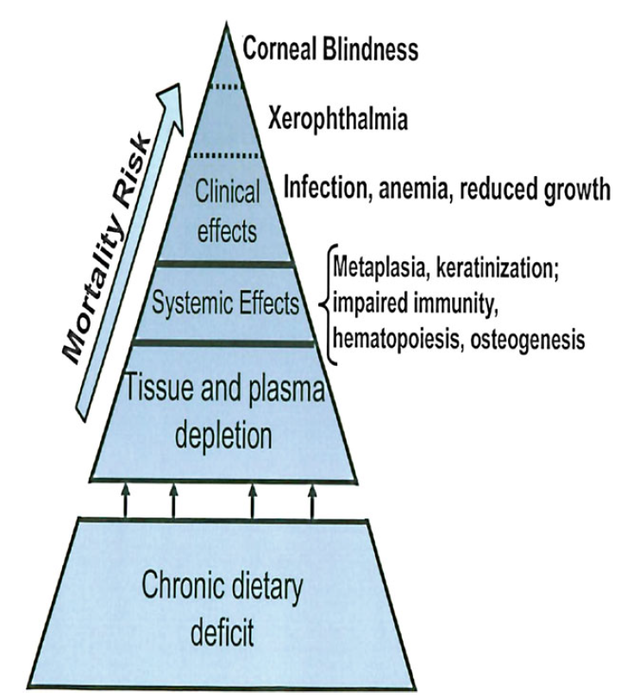
Stages of vitamin A deficiency
Mild to moderate deficiencies can have no clinical signs but still affect a person’s well-being and development.
Clinical signs appear only with extreme micronutrient deficiency.
Clinical signs observed in a population indicate that a substantial proportion of the population suffers from deficiency, affecting health and development.
Vitamin A Deficiency
Figure: De Pee, S., Taren, D. and Bloem, M.W. eds., 2017

Slide 16
Evaluation of vitamin A status
Vitamin A deficiency results from a dietary intake of vitamin A that is inadequate to satisfy physiological needs.
It may be exacerbated by high rates of infection, especially diarrhea and measles
  Retinol is the main circulating form of vitamin A in blood and plasma
  Serum retinol levels reflect liver vitamin A stores when they are severely depleted or extremely high
  Serum retinol is best used for the assessment of subclinical/biochemical vitamin A deficiency in a population (not in an individual)
  A plasma or serum retinol concentration <0.70 μmol/L indicates subclinical vitamin A deficiency in children and adults, and a concentration of <0.35 µmol/L indicates severe vitamin A deficiency
Source: Tanumihardjo et al., 2016
Notes:
Tanumihardjo, S. A., Russell, R. M., Stephensen, C. B., Gannon, B. M., Craft, N. E., Haskell, M. J., Lietz, G., Schulze, K., & Raiten, D. J. (2016). Biomarkers of Nutrition for Development (BOND)-Vitamin A Review. The Journal of nutrition, 146(9), 1816S–48S. https://doi.org/10.3945/jn.115.229708

Slide 17
Evaluation of iodine status
Urinary iodine concentration is currently the most practical biochemical marker for iodine status.
This approach assesses iodine status only at the time of measurement, whereas thyroid size reflects iodine nutrition over months or years.
Therefore, even though populations may have attained iodine sufficiency on the basis of median urinary iodine concentration, goiter may persist, even in children.
Source: Eastman, C.J. and Zimmermann, M.B., 2018.

Slide 18
Epidemiological criteria for assessing iodine nutrition based on median urinary iodine concentrations of school-age children (≥6 years)
Median urinary iodine (µg/l) | Iodine intake | Iodine status
< 20 | Insufficient | Severe iodine deficiency
20–49 | Insufficient | Moderate iodine deficiency
50–99 | Insufficient | Mild iodine deficiency
100–199 | Adequate | Adequate iodine nutrition
200–299 | Above requirements | Likely to provide adequate intake for pregnant/lactating women, but may pose a slight risk of more than adequate intake in the overall population
≥300 | Excessive | Risk of adverse health consequences (iodine-induced hyperthyroidism, autoimmune thyroid diseases)
*Applies to adults, but not to pregnant and lactating mother
Source: Eastman, C.J. and Zimmermann, M.B., 2018.
Notes:
Eastman CJ, Zimmermann MB. The Iodine Deficiency Disorders. [Updated 2018 Feb 6]. In: Feingold KR, Anawalt B, Boyce A, et al., editors. Endotext [Internet]. South Dartmouth (MA): MDText.com, Inc.; 2000-. Available from: https://www.ncbi.nlm.nih.gov/books/NBK285556/

Slide 19
Evaluation of iron status
Heme iron may be found in meat, poultry, fish
Non-heme iron may be found in cereal, greens, peas/beans, eggs, dried fruits
Vitamin C improves iron absorption. Vitamin C may be found in fruits such as oranges, guava, lemon, etc.
Stages of iron deficiency:
    Depletion present with decreased serum ferritin
    Iron deficiency present with decreased transferrin saturation
    Iron deficiency anemia present with decreased hemoglobin (Hgb) and decreased mean corpuscular volume (MCV)
Source: Lee, Robert and Nieman, David. Nutritional Assessment 5th edition. McGraw Hill 2010.
Notes:
Lee, Robert and Nieman, David. Nutritional Assessment 5th edition. McGraw Hill 2010.

Slide 20
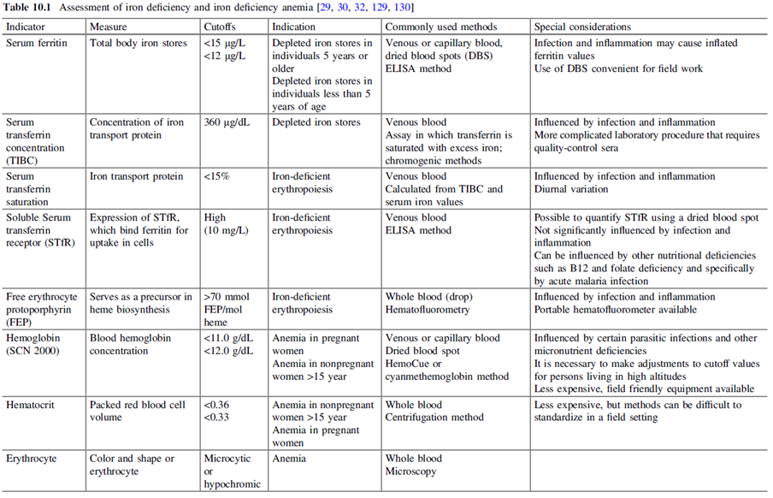
Indicators used to detect iron deficiency and iron deficiency anemia
Assessment of iron deficiency and iron deficiency anemia
Source of table: de Pee, S., Taren, D., & Bloem, M. W. (Eds.). (2017). Nutrition and health in a developing world (3rd ed.). Humana Press. DOI 10.1007/978-3-319-43739-2
Notes:
29. WHO. Haemoglobin concentrations for the diagnosis of anaemia and assessment of severity. Vitamin and mineral
nutrition information system. Geneva: World Health Organization (WHO/NMH/NHD/MNM/11.1); 2011.
Available from: http://www.who.int/vmnis/indicators/haemoglobinpdf.
30. Gibson R. Principles of nutritional assessment. 2nd ed. Oxford: Oxford University Press; 2005.
32. Lynch S, Green R. Assessment of nutritional anemias. In: Ramakrishnan U, editor. Boca Raton: Nutritional
Anemias, CRC Press LLC; 2001. p. 23–42.
129. WHO. Serum ferritin concentrations for the assessment of iron status and iron deficiency in populations. Vitamin
and mineral nutrition information system. Geneva: World Health Organization,
WHO/NMH/NHD/MNM/11.2;2011. Available from: http://www.who.int/vmnis/indicators/serum_ferritinpdf.
130. WHO. Assessing the iron status of populations: report of a joint World Health Organization/Centers for Disease
Control and Prevention technical consultation on the assessment of iron status at the population level. 2nd edn.
Geneva: World Health Organization; 2007. Available from: http://www.who.int/nutrition/publications/
micronutrients/anaemia_iron_deficiency/9789241596107.pdf.

Slide 21
Evaluation of iron status
Serum ferritin combines with Fe and is stored in liver, spleen, and bone marrow.
  Most sensitive and best test to detect early iron deficiency
Transferrin carries Fe in blood. Associated and used to calculate TIBC (total iron binding capacity).
  When TIBC goes up, iron level is low. When TIBC goes down, iron level is high.
Hemoglobin (Hgb) is the molecule in red blood cells (RBCs) that holds iron and allows the cells to carry oxygen to the body tissues.
Hematocrit (Hct) is expressed as RBCs as a percentage of total blood volume.
Source: Lee, Robert and Nieman, David. Nutritional Assessment 5th edition. McGraw Hill 2010.
Notes:
Lee, Robert and Nieman, David. Nutritional Assessment 5th edition. McGraw Hill 2010.

Slide 22
Limitations of biochemical methods
Measurement error is possible; measurement error is the difference between the true value of the biomarker and the measured value.
Measurement error can be happened either by biological (preanalytical) or laboratory (analytical) error.
Some biomarkers can have day-to-day or even within-day variability.
Some nutrients do not have good, specific biomarkers.
Biochemical assessments require training, equipment, and supplies, which can be costly.
As with all nutritional assessment, consent is important, and biochemical assessments in particular can be invasive.
Source: Laboratory Issues: Use of Nutritional Biomarkers | The Journal of Nutrition | Oxford Academic (oup.com) & Biomarkers: Potential Uses and Limitations (nih.gov)
Notes:
Laboratory Issues: Use of Nutritional Biomarkers | The Journal of Nutrition | Oxford Academic (oup.com)
Biomarkers: Potential Uses and Limitations (nih.gov)

Slide 23
Clinical methods
Clinical assessment includes checking for visible signs of nutritional deficiencies such as bilateral pitting edema, emaciation (a sign of wasting, which is loss of muscle and fat tissue as a result of low energy intake and/or nutrient loss from infection), hair loss, and changes in hair color.
Clinical nutrition assessment also includes checking for or asking clients about symptoms of infection that can increase nutrient needs (e.g., fever) and nutrient loss (e.g., diarrhea and vomiting), as well as medical conditions (e.g., HIV, celiac disease) that impair digestion and nutrient absorption and increase the risk of developing malnutrition
Source: Module 2. Nutrition Assessment and Classification (NACS User's Guide) (fantaproject.org)

Slide 24
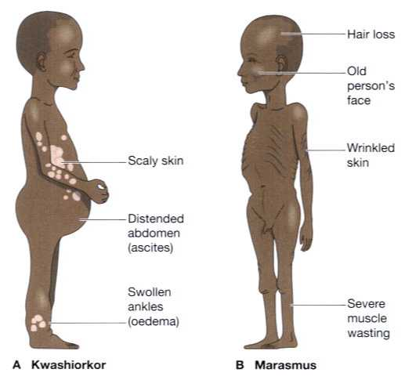
Sign and symptoms of marasmus and kwashiorkor
Notes:
Haven’t found any Asian kid photo

Slide 25
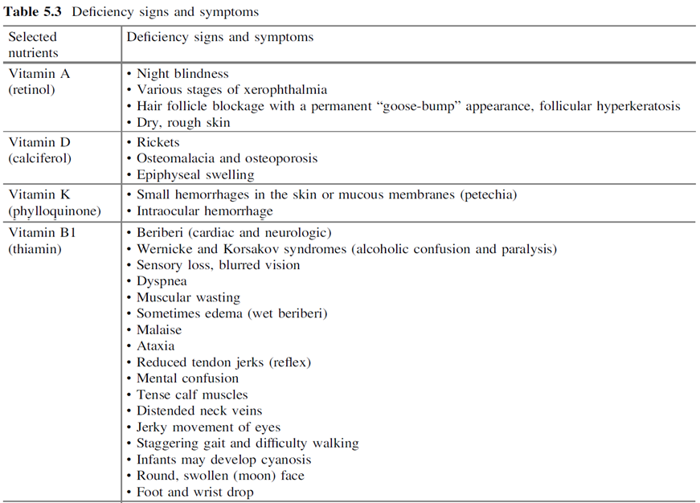
Clinical signs and symptoms of micronutrient deficiency
Source of table: de Pee, S., Taren, D., & Bloem, M. W. (Eds.). (2017). Nutrition and health in a developing world (3rd ed.). Humana Press. DOI 10.1007/978-3-319-43739-2
Notes:
Taken from the book “Nutrition and health in a developing world”

Slide 26
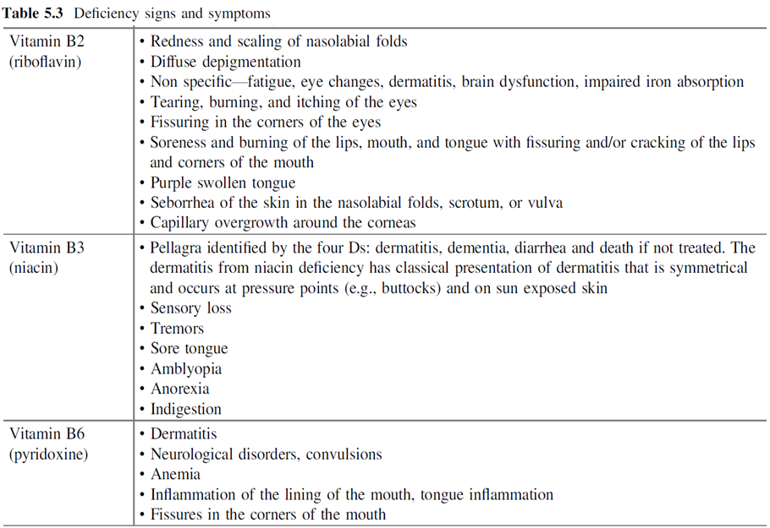
Clinical signs and symptoms of micronutrient deficiency (continued)
Source of table: de Pee, S., Taren, D., & Bloem, M. W. (Eds.). (2017). Nutrition and health in a developing world (3rd ed.). Humana Press. DOI 10.1007/978-3-319-43739-2

Slide 27
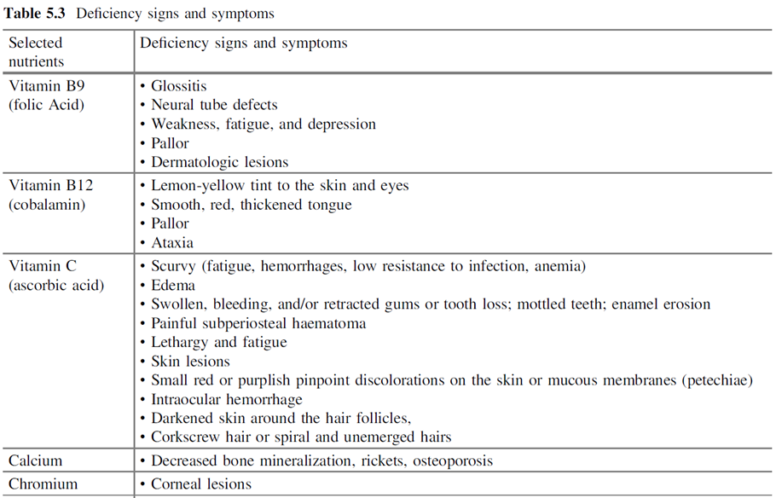
Clinical signs and symptoms of micronutrient deficiency (continued)
Source of table: de Pee, S., Taren, D., & Bloem, M. W. (Eds.). (2017). Nutrition and health in a developing world (3rd ed.). Humana Press. DOI 10.1007/978-3-319-43739-2

Slide 28
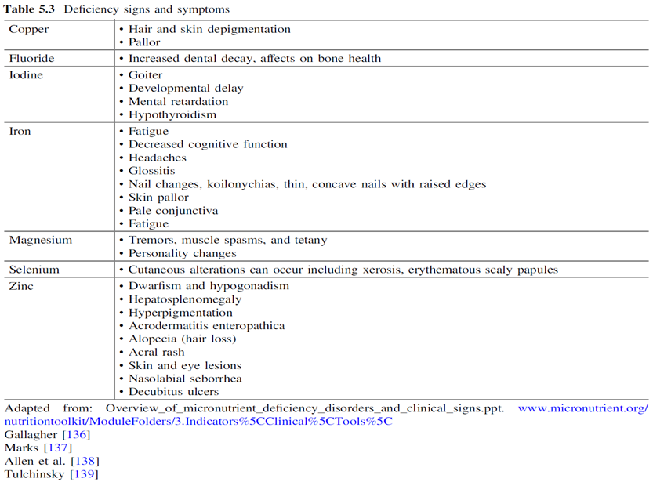
Clinical signs and symptoms of micronutrient deficiency (continued)
Source of table: de Pee, S., Taren, D., & Bloem, M. W. (Eds.). (2017). Nutrition and health in a developing world (3rd ed.). Humana Press. DOI 10.1007/978-3-319-43739-2
Notes:
Adapted from: Overview_of_micronutrient_deficiency_disorders_and_clinical_signs.ppt. www.micronutrient.org/
nutritiontoolkit/ModuleFolders/3.Indicators%5CClinical%5CTools%5C
Gallagher [136]
Marks [137]
Allen et al. [138]
Tulchinsky [139]
136. Gallagher ML. Intake: the nutrients and their metabolism. In: Mahan LK, Escott-Stump S, Raymond JL, editors.
Krause’s food and the nutrition care process, 13th ed. St. Louis: Elsevier Saunders; 2012. p. 32–128.
137. Marks J. The vitamins: their role in medical practice. Boston: Springer MTP Press Limited; 1985.
138. Allen L, de Benoist B, Dary O, Hurrell R. Guidelines on food fortification with micronutrients. Geneva: World
Health Organization and Food and Agricultural Organization of the United Nations; 2006.
139. Tulchinsky TH. Micronutrient deficiency conditions: global health issues. Public Health Rev. 2010;32:243–55.

Slide 29
Dietary methods
Dietary assessment provides information on dietary quality and quantity of macro- and micronutrients consumed by an individual or population.
Dietary assessment can be used to determine excess intakes (especially of calories) as well as nutrient deficiencies from a poor diet.
Dietary assessment can identify risk factors that can lead to non-communicable diseases such as diabetes, cardiovascular diseases, and cancer.
  Salt, sugar, fat, ultra-processed foods
Source: Dietary assessment (fao.org)

Slide 30
Dietary assessment methods
Dietary assessment methods
Indirect
National
Household
Food balance sheets
Household consumption and expenditure surveys
1.Estimated food record
2. Weighed food record
Direct
Retrospective
1. Dietary
24-hour recall
2. Food frequency questionnaire
3. Indicators of dietary quality
Innovative technologies
1. Mobile-based technologies
2. Automated multiple pass method (AMPM)
3. Image-assisted dietary assessment methods
Prospective
Source: Adapted from Dietary assessment (fao.org)

Slide 31
24-hour recall
A 24-hour dietary recall (24HR) is a structured interview intended to capture detailed information about all foods and beverages eaten by a respondent in the past 24 hours.
This can be done via a face-to-face interview or telephone.
The interview is often structured, with a standardized and pretested protocol involving probing questions that help the respondent remember all the items consumed and relevant food and beverage descriptions.
Information on food type, preparation methods, recipes, brand names of commercial products, and estimated portion size are usually required.
Trained staff must conduct the interview to prompt for details, such as cooking methods, portion sizes, beverages, snacking, and consumption outside the home.
Source: 24-hour Dietary Recall (24HR) At a Glance | Dietary Assessment Primer (cancer.gov)

Slide 32
Portion size used in dietary assessment
Generally, individuals are unable to describe portion size accurately
They would have difficulties conceptualizing serving sizes, thus standardized portion sizes are used
To help quantify the amount of a food consumed, use:
  Portion size estimation aids (photographs, everyday reference objects, household utensils, 3-D food models, containers with rice or beans
  Categorical sizes (small, medium, large)
  Measurement using household utensils and food units (1 slice, 1 egg)
  Standard units of measurement (gram, ounce, millimeters)
  Other quantifying components (e.g., food models, cardboard cut-outs, etc.)
Source: Dietary assessment methods in epidemiologic studies (nih.gov)

Slide 33
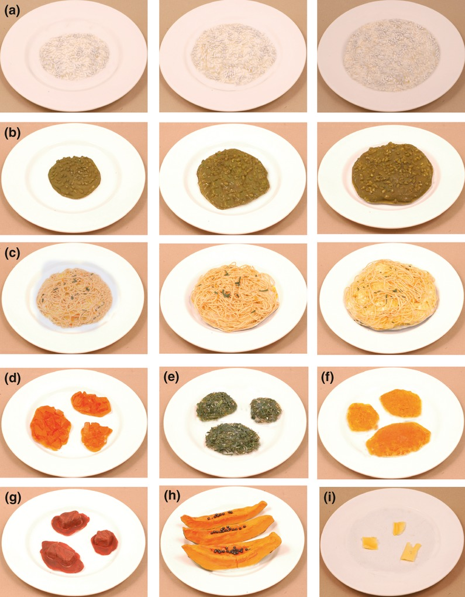
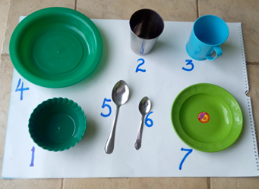
Portion size and toolkits used in dietary assessment
Photo credit: Stella Nyamsangia; photo was taken in Tanzania
Photographs of food models depicting different portion sizes. (a) Rice, (b) green gram, (c) noodles, (d) carrots, (e) dark green leafy vegetables, (f) lentils, (g) fish, (h) papaya, (i) butter.
Source: Lanerolle, 2013
Notes:
Food models for portion size estimation of Asian foods - Lanerolle - 2013 - Journal of Human Nutrition and Dietetics - Wiley Online Library

Slide 34
Food frequency questionnaire
A food frequency questionnaire (FFQ) consists of a finite list of foods and beverages with response categories to indicate usual frequency of consumption over a specified time period.
FFQ rely on a longer recall period to capture foods that are not consumed every day but are still part of an individual's typical diet.
FFQs can be self-administered or conducted by an interviewer, for example, when literacy is low.
Source: Food Frequency Questionnaire at a Glance | Dietary Assessment Primer (cancer.gov)

Slide 35
Dietary diversity
Dietary diversity can be measured at either the household or individual level.
Household dietary diversity has been shown to be associated with caloric and protein adequacy and household income.
Individual dietary diversity indices, specifically the Minimum Dietary Diversity for Women (MDD-W) and the Minimum Dietary Diversity (MDD) for children 6-23 months, have been shown to be a rough proxy for diet quality and nutrient adequacy.
Source: https://inddex.nutrition.tufts.edu/data4diets/data-source/dietary-diversity

Slide 36
Approaches to measure dietary diversity
Dietary Diversity Score | Data collection level | Number of food groups | Recall period | Purpose | Universal cut-off? | Promoted by
Household level measures
Household dietary diversity score (HDDS) | Household | 12 | 24 hours | Household dietary diversity and proxy for household food access and socioeconomic status | No | FAO
Food consumption score (FCS) | Household | 8 | 7 days | Measures "usual" household consumption; Standardized food group weights are used to construct index. | Yes | WFP
Individual level measures
Minimum Acceptable Diet (MAD) | Infant/child (6-23 months) | 8 (from MDD) | 24 hours | Measures both minimum dietary diversity and minimum meal frequency. | Yes | WHO
Minimum Dietary Diversity (MDD) | Infant/child (6-23 months) | 8 | 24 hours | Measures infant and child dietary quality and adoption of complementary feeding practices | Yes | WHO
Minimum Dietary Diversity for Women (MDD-W) | (Individual) Women 15-49* | 10 | 24 hours | Dichotomous indicator that measures the dietary diversity of an individual woman; associated with nutrient adequacy in many contexts and can be used as a proxy for overall diet quality | Yes | WHO, USAID
*Women of reproductive age
Source: https://inddex.nutrition.tufts.edu/data4diets/data-source/dietary-diversity
Notes:
(FAO & FHI, 2016; Moursi et al., 2008)

Slide 37
Vital health statistics as indirect nutritional assessment method
An analysis of vital statistics such as mortality and morbidity data will identify groups at high risk and indicate the extent of that risk.
Mortality in the under-5 age group is particularly related to malnutrition. Infant mortality rate, rate of low-birth-weight babies, and life expectancy can also be used as malnutrition indicators.
These rates are influenced by nutritional status and are useful for understanding the nutritional status of a population. However, mortality data alone do not provide a satisfactory picture of the nutritional status of a population.
Data on morbidity (e.g., hospital data or data from community health and morbidity surveys) particularly in relation to protein energy malnutrition, anemia, xeropthalmia, and other vitamin deficiencies, endemic goiter, diarrhea, measles, and parasitic infestations can be valuable in providing additional information about the nutritional status of the community.
Source: Nutritional assessment (slideshare.net)
Notes:
https://apps.who.int/iris/bitstream/handle/10665/41780/WHO_MONO_53_(part3).pdf;jsessionid=0A3C333743B8A70D974FA47FA5F9576D?sequence=3

Slide 38
Indirect dietary methods: Food balance sheets
Food balance sheets (FBS) from the Food and Agriculture Organization of the United Nations (FAO) are used to assess the national availability of food for consumption.
They are widely used in the food and agriculture sectors to monitor global food and dietary patterns.
FAO FBS only provide data on annual per capita consumption of energy, protein, and fat (not micronutrients).
FBS have also been used to set public health priorities, formulate policies, undertake inter-country comparisons, monitor trends over time, and estimate the likelihood of micronutrient deficiencies.
Source: Dietary assessment (fao.org)

Slide 39
Household consumption and expenditure surveys (HCES)
These surveys provide the total amount of food available for consumption in the household, generally excluding food eaten away from home.
HCES can be used to track consumption patterns.
  Consumption can vary among individuals within a household, especially by gender and age.
They can also be used to monitor food security globally.
Information on food consumption at the household level allows the derivation of variability parameters, such as the coefficient of variation of food consumption, which are used to estimate undernourishment in a population.
Source: Dietary assessment (fao.org)

Slide 40
Takeaway messages
Nutritional assessment can identify individuals and populations at risk of malnutrition (over- and undernutrition).
Different methods of nutritional assessment (anthropometric, biochemical, clinical, and dietary assessment) can identify poor growth in children and risk of non-communicable diseases in adults.
Overall, nutritional assessment is essential for:
  Identification of nutrient deficiencies and undernutrition in adults and children
  Development of public health nutrition interventions, programs, and policies for nutrition-related disease prevention
  Monitoring the efficacy and effectiveness of nutrition interventions, programs, and policies

Slide 41
Thank you!
Notes:
This concludes topic 6 of module one. Thank you for your attention.

